Slide 1

Skills for Study student guide – LTI Access
www.skillsforstudy.com

Slide 2
About LTI access
What you need to know:
LTI access lets users access the service from within an institution’s VLE/LMS.
Direct links to specific areas and resources within the service can be created without the need for users to login to the service.
LTI access also allows user scores to be passed back to the VLE/LMS gradebook, if this option is enabled by institution administrators.

Slide 3
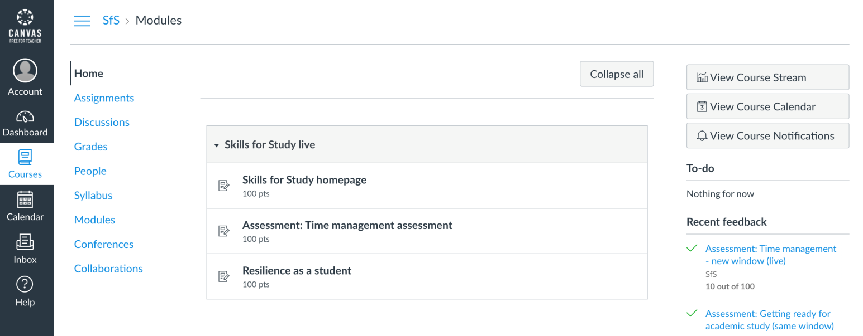
How to access Skills for Study
Click on a link to Skills for Study from your VLE
[Example screenshot shown below. Please replace with a screenshot of your VLE/LMS setup]
Students will then be automatically authenticated.

Slide 4
How to use Skills for Study
Start working on the activity, video, section or module that your lecturer / librarian / study skills advisor directed to you.
Complete the activity and then browse the additional content available in Skills for Study.

Slide 5
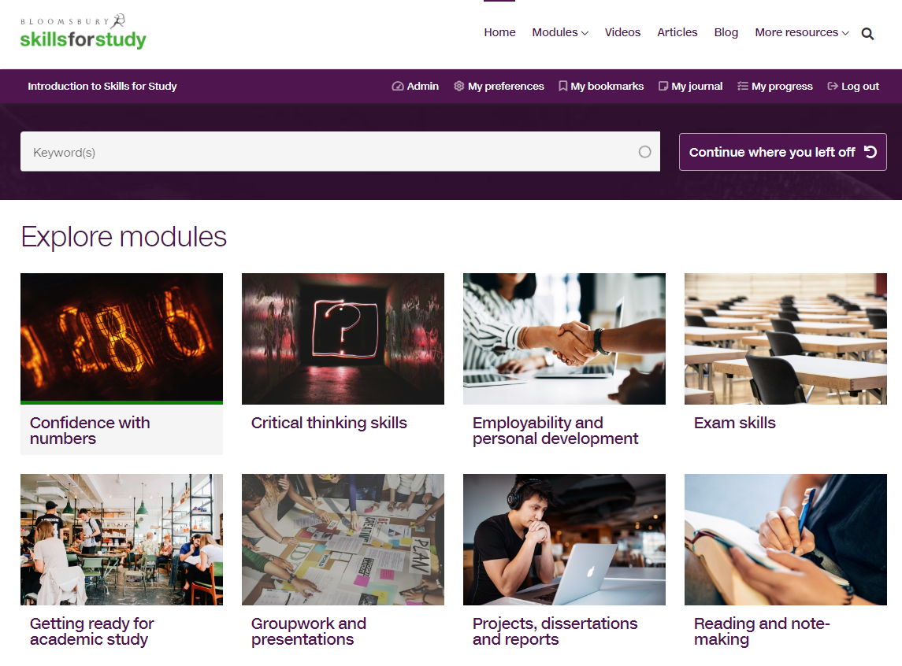
How to use Skills for Study
Once at the Skills for Study student homepage, browse the skills you can work on, or choose from the ‘modules’ dropdown.

Slide 6
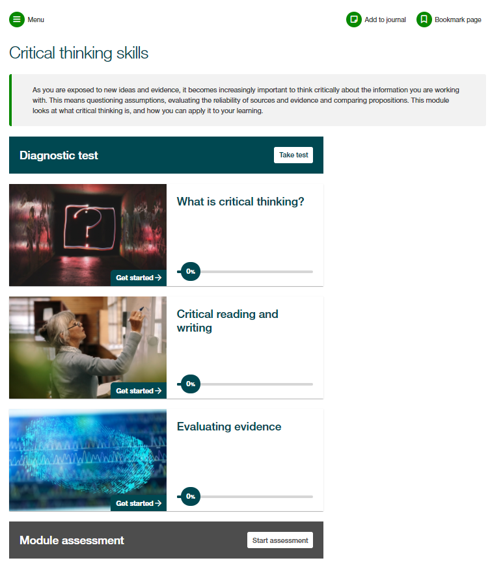
How to use Skills for Study
Each module is structured in the same way, with a module introduction, diagnostic test, sections of content and then a module assessment.
We would always recommend that you complete the diagnostic test first; this will help you to identify your strengths and areas for development so that you can prioritise your time.

Slide 7
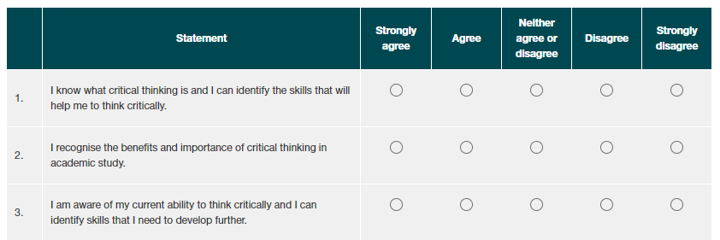
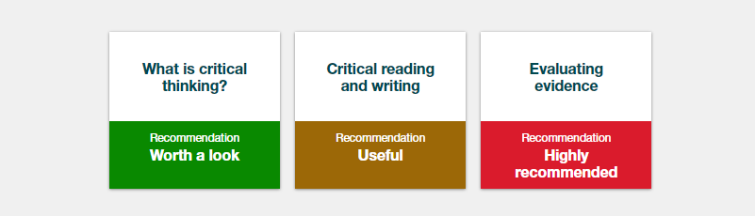
How to use Skills for Study
Complete the survey to see your personalised recommendations.
Red shows content which is highly recommended
Gold shows content which would be useful
Green shows content which is worth a look
You can then click on the section name to go straight through to the activities and start developing your study skills!

Slide 8
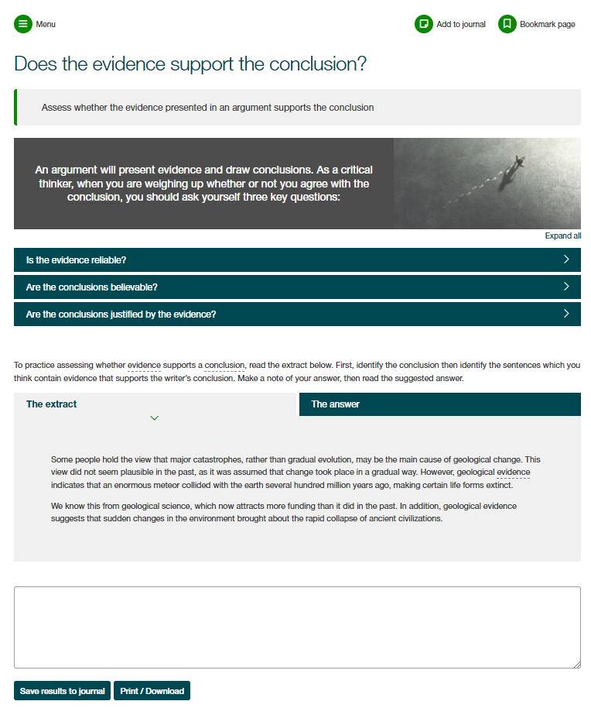
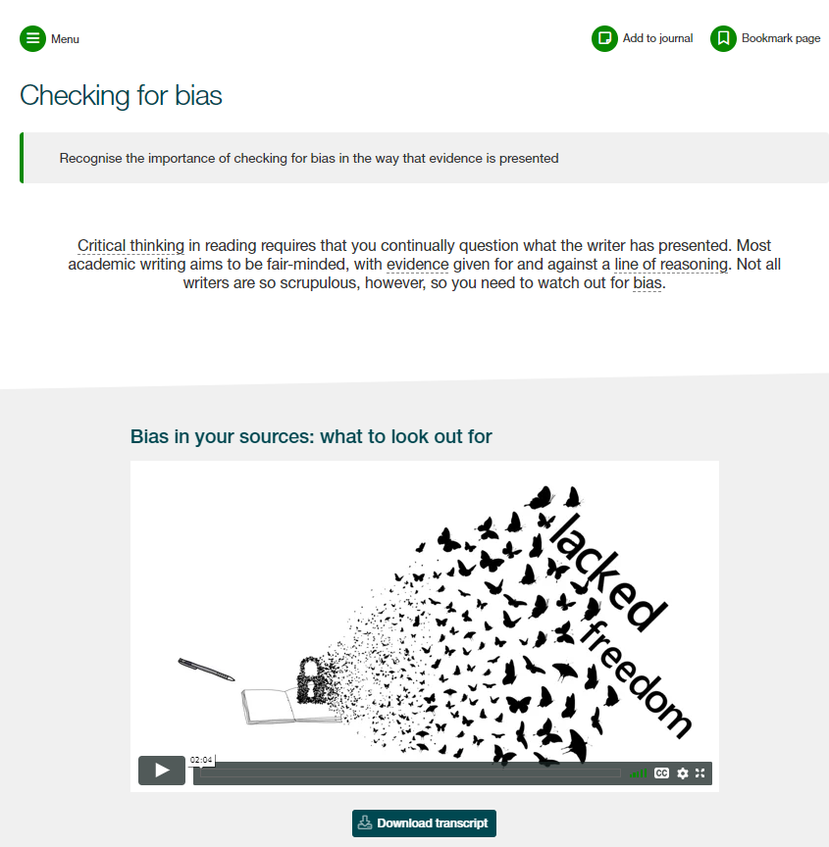
How to use Skills for Study
Work through the engaging activities and practice exercises to build your skills.
Save notes and personal reflections in your journal as you go and bookmark pages to come back to them later

Slide 9
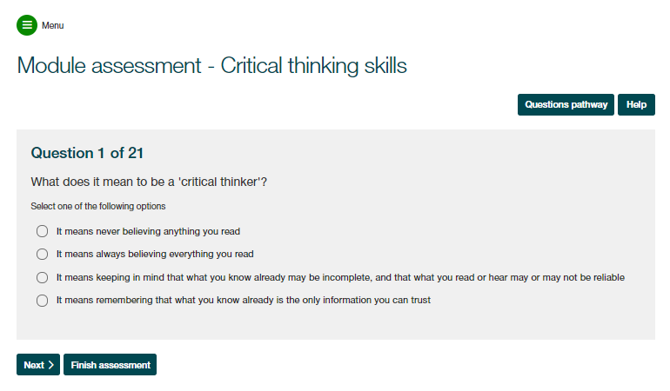
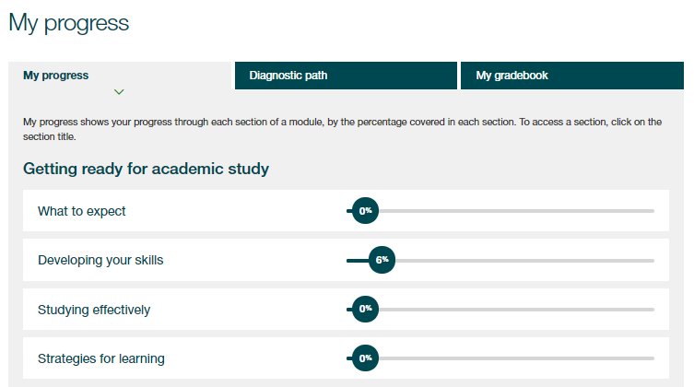
How to use Skills for Study
At the end of the module you’ll find your module assessment, which will help you put what you’ve learnt into practice and check if you’ve absorbed all the information.
Use the ‘My Progress’ section to review your completion of activities and track your assessment scores

Slide 10
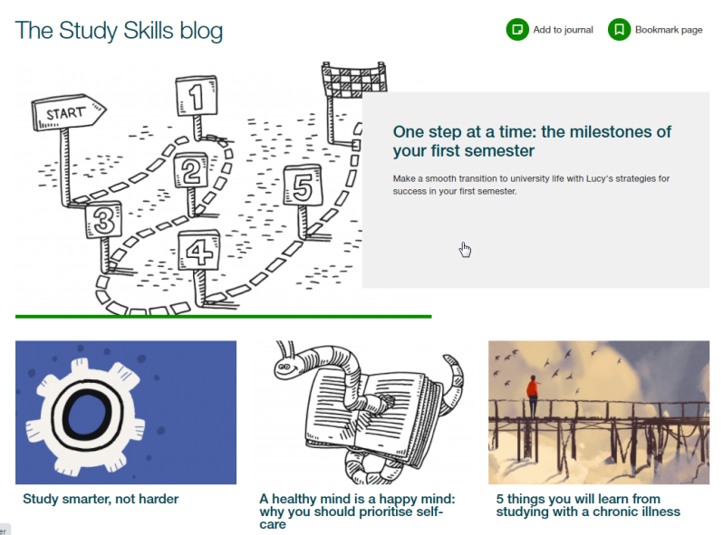

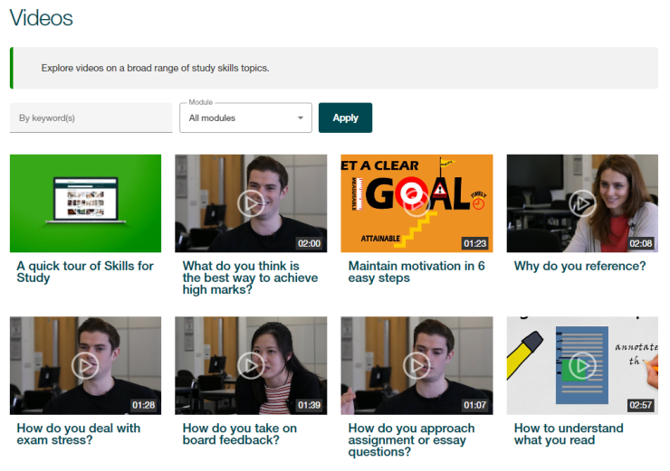
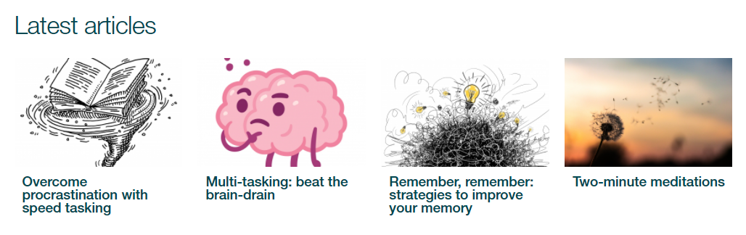
How to use Skills for Study
Explore the Editor’s Highlights, videos, blog and articles for bitesized content to boost your learning

